Slide 1


Class Login Process
Open a browser and go to
https://portal.office.com

Slide 2
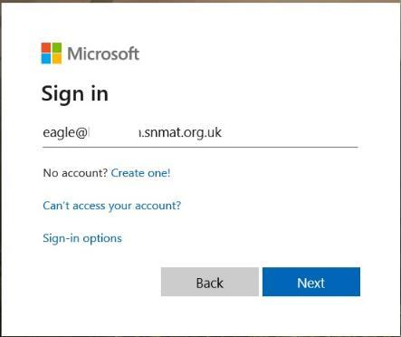
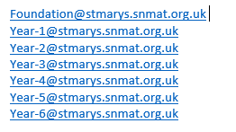
Choose and type in the correct class email address at the login prompt and press ‘Next’.

Slide 3
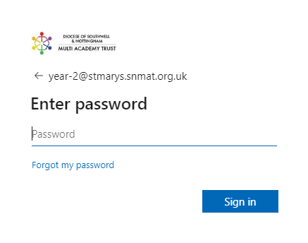
Type in the password and click ‘Sign in’.
The password for all classes is:
Mary2020

Slide 4
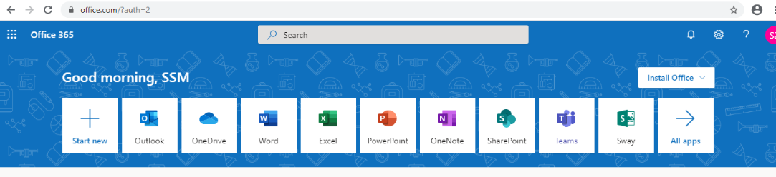
When you are in Office 365, click on ‘Teams’.

Slide 5
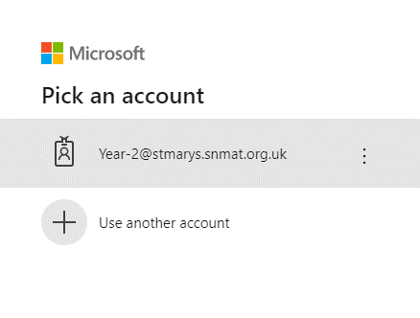
You may be asked to login again, use the remembered credentials.

Slide 6
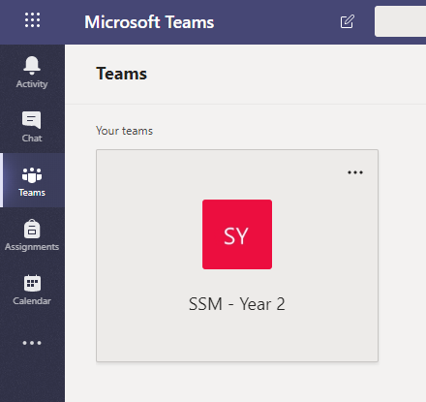
Select your team

Slide 7
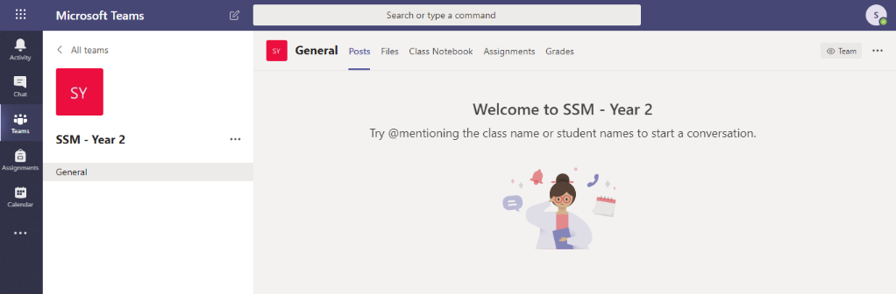
To get to your work click on ‘Files’. Work will be set daily by the class teacher – please work through the tasks by following the instructions provided. Any paper based tasks should be completed in the exercise book provided. Online tasks may also be set. Work will be checked by the teacher when pupils return to school.

Slide 8
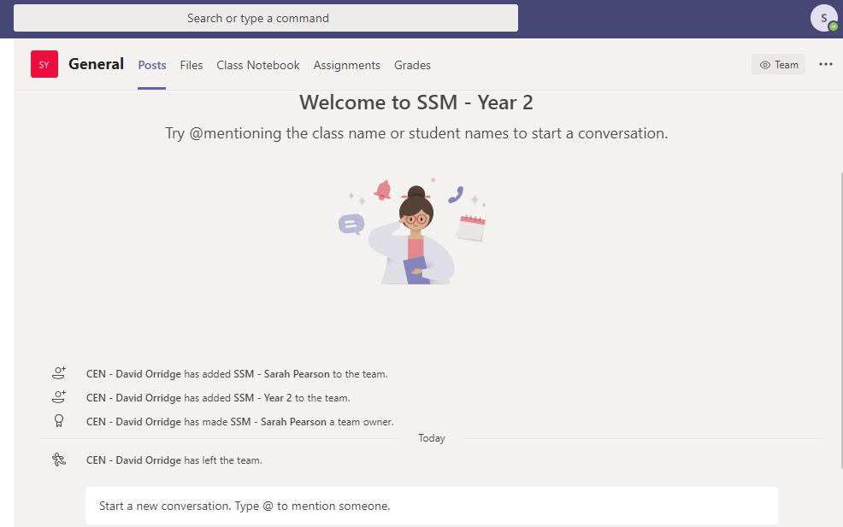
If you need help, or have a question, you can get in touch with the class teacher through the chat facility. Teachers will be available between 9am -3pm to respond to these. Please start your message with your name so the teacher knows who they are responding to.

