Slide 1
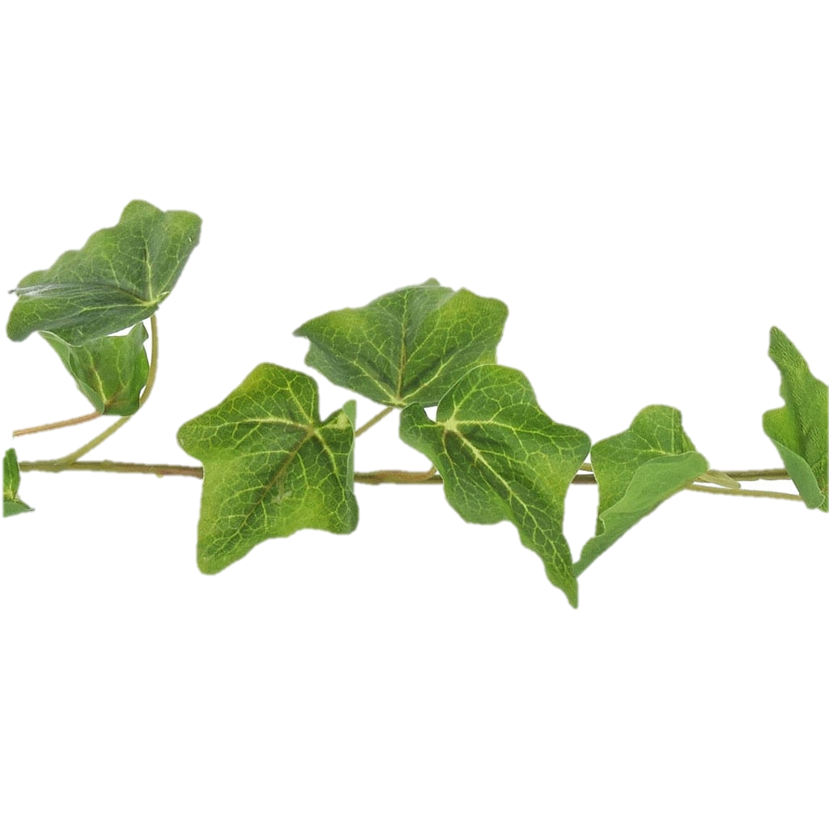

Y6 Welcome Meeting
September 2024

Slide 2
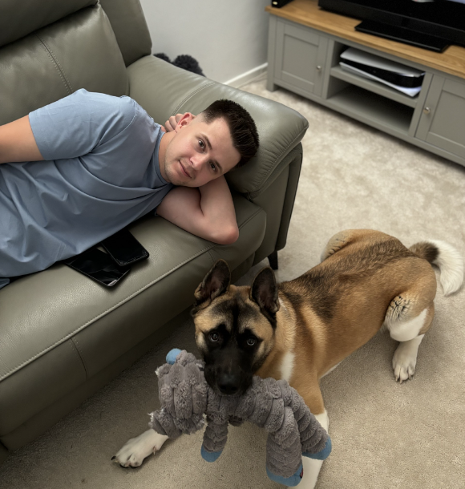
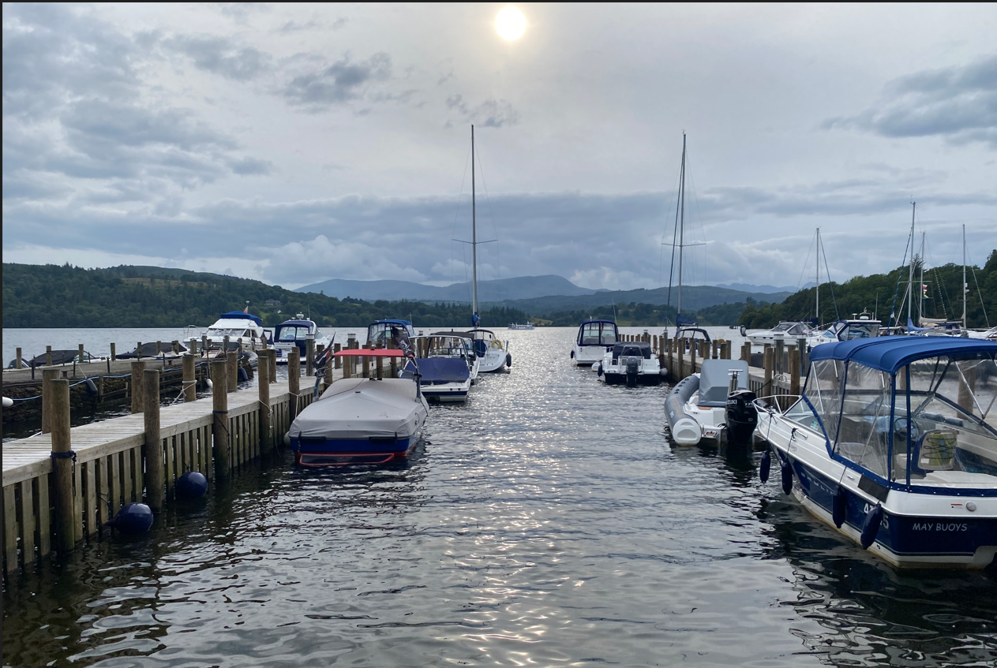
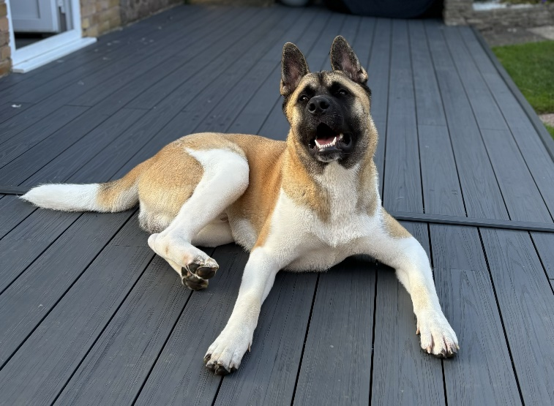
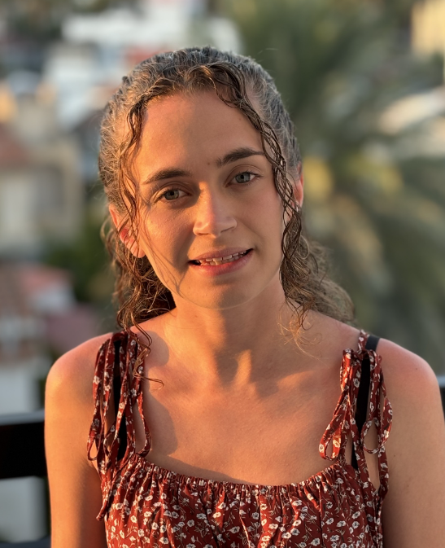
Miss Smith
A little bit about me:
This is my third year at St Marys and first in year 6.
I have a little, crazy family which keeps me on my toes! My puppy, Hugo, thinks he rules the roost and keeps us entertained all day long.
My classroom:
I love a practical approach to learning as I find this captures children’s interests and makes it more exciting.
I am firm but fair and will strive for everyone to achieve their best.
I will encourage the children to take risks and make mistakes, as this is a natural part of learning.

Slide 3
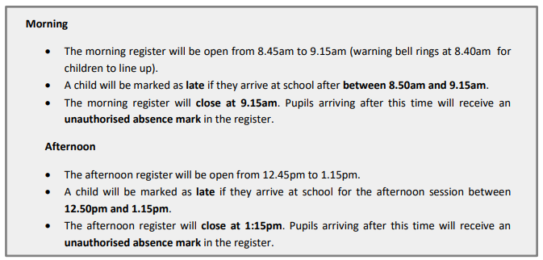
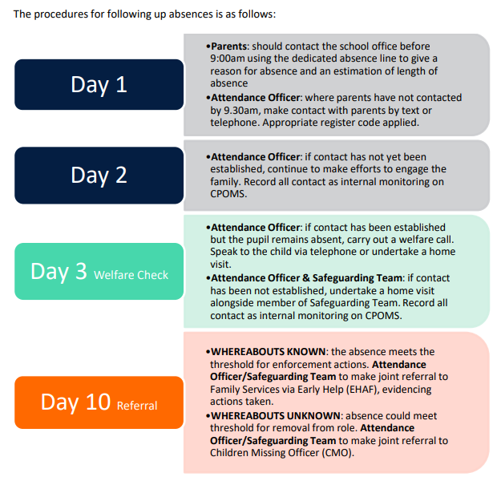
Attendance and Punctuality
Session Times
School Absences

Slide 4
Health and Safety
Please find a link to our ‘Medicines in School’ policy: https://stmarymagdaleneprimary.secure-primarysite.net/medicines-in-school/
Nut Free school – please do not send nut products into school.

Slide 5

Our School Values
Notes:
These are our school values and these are all things which I really do value in the classroom. I want all children to have respect, both for themselves and for others so they can enable themselves and others to make the progress they desire. I think respect just goes a long way in life as a human being and through developing an ability to understand and tolerate differences through respect is crucial. I also think forgiveness is crucial in life, but especially a school. Mistakes are made and it is part of a learning process, but the ability to forgive is healthy and to recognise that we all make mistakes. I also try to promote honest, courage and love throughout the school day by allowing the children time to reflect, self-assess and to ask any questions they may have.

Slide 6
Reading
Reading is vital! Please ensure that you read with your child at least 5 times a week and record this in their reading diaries.
Reading diaries will be checked by staff regularly throughout the week and reminders sent to families that haven't read.
It is important to remember that reading is not just about 'reading words' and involves comprehension too!
Tips to help at home with reading: https://www.stmarymagdaleneprimary.co.uk/reading-strategies/

Slide 7

Times tables
Times tables are vital and is something that we strive to learn and recall fluently.
We encourage the use of TTRS and would recommend the children go on it for a minimum of 15-20 minutes per week. As a class, we offer incentives and competitions against one another to make it fun and exciting!

Slide 8
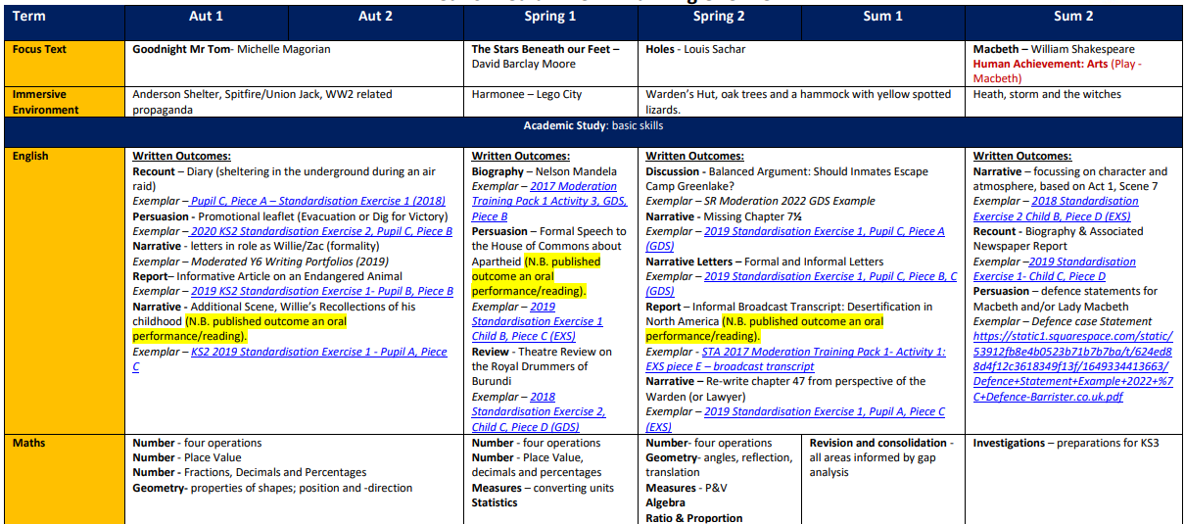
Our Curriculum

Slide 9
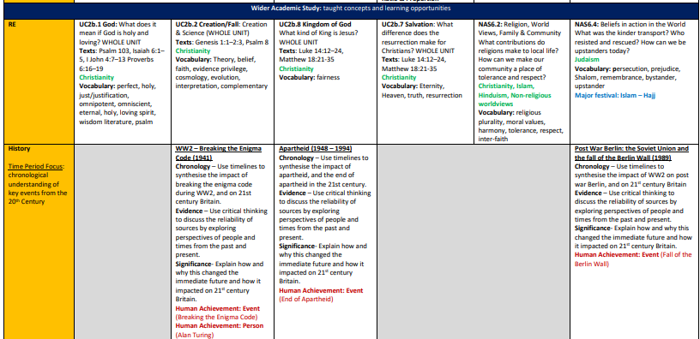
Our Curriculum

Slide 10
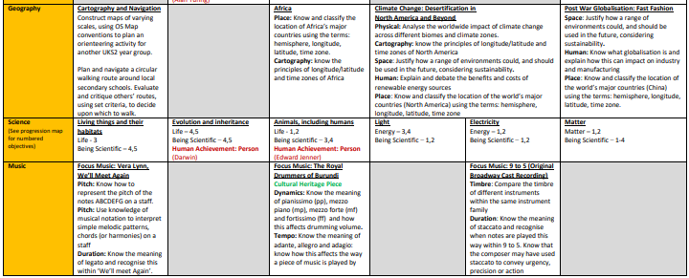

Our Curriculum

Slide 11
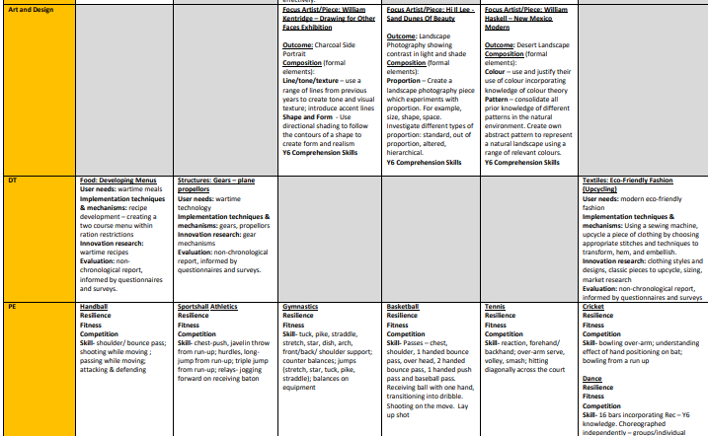
Our Curriculum

Slide 12
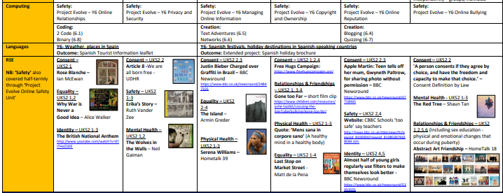
Our Curriculum

Slide 13
Involving you...
We share your children's targets and progress with you regularly through:
15 minute year group allocated slots before school to have a look at your children's books (Friday 8.30am – 8.45am)
Send books home twice per half term for you to look over at home. These will be sent home on a Friday and must be returned the following Monday.
This will also give you the chance to understand and see what your child's targets are in certain subjects.

Slide 14
Homework
Homework for English and Maths is set on a Friday for the following Friday. Homework clubs will be held weekly in classrooms for children who do not complete their homework.
This is set via www.maths.co.uk and www.spag.com these can be accessed via our website ‘Homework’ tab (under Children).
Spellings will now be set weekly on Spelling Shed. Your child will come home with a username and password to access these https://www.edshed.com/en-gb/login/school These should be practised 5 times per week.
Reading 5 times per week.
Homework is extremely important, as we use this to plan our lessons and ensure that the children have a secure subject knowledge. It also helps us to identify areas where they may need extra support!

Slide 15

Proposed Fieldwork
Please be aware that these are not guaranteed and have to be risk and context assessed before going ahead.
Autumn
Circular route around Sutton
Spring
Trent Bridge Classrooms (Date TBC)
Summer
London Trip (13th June 2025)
Bletchley Park (6th November)
If you haven’t done so, please complete the Microsoft form before you leave

Slide 16

PE and Sports
We are supported by Next Level Sports
https://www.nextlevelsportsltd.com/
Last year, we were awarded the Gold School Games Award.
One PE lesson each week will be taught by a qualified Sports Coach.
Our PE days are…
PE Uniform
Plain white T-shirt
Plain navy blue shorts
Plain navy jogging bottoms
Plain plimsols or trainers
Can we kindly request that you label all children's clothing clearly to prevent losses. Please note that earrings are not allowed to be worn for PE.

Slide 17

Diary Dates
Date TBC - Y6 SATS Parents Information evening 15:30
10.10.24 – Harvest festival @ Church (If you would like to walk with us, please let me know)
WC 14.10.24 – Parents evening (Monday face-to-face)
6.11.24 – Y6 trip to Bletchley Park
4.12.24 – Christmas panto
12.12.24 – Christmas disco
20.12.24 – Break up for Christmas

Slide 18
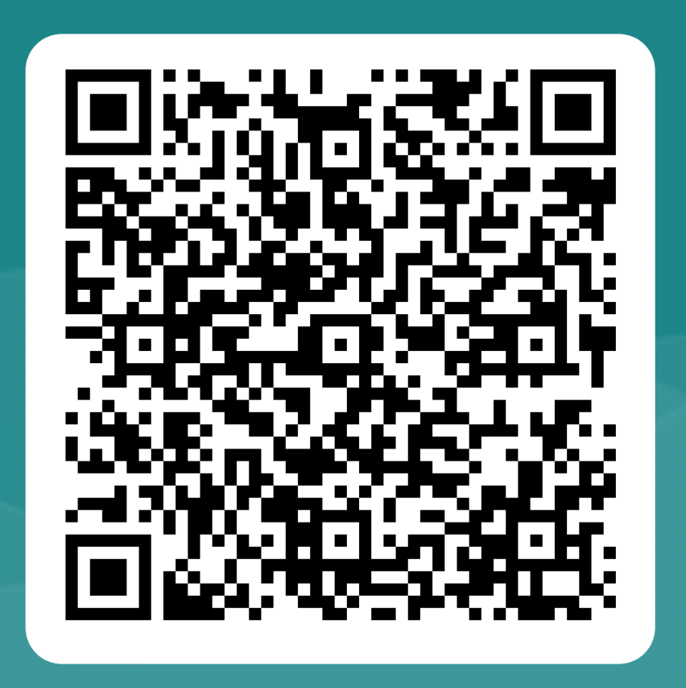
Questions and Feedback
Please use the QR code to provide feedback on tonight.
If you have any questions that we didn’t have time to answer, there is a n opportunity at the end of the questionnaire.

